Slide 1
The Road on Becoming the Next E-Sports Professional
Edward Lee

Slide 2
Table of Contents
What does it take to become an “Ownage” Professional E-Sports Player?
About the Dataset
Noobs vs Casual Competitors vs Pros
Recommendations
Further Research

Slide 3
About the Dataset
Dataset is called SkillCraft1 Master Table Dataset Data Set from the University of California, Irvine.
Blizzard’s StarCraft II
Data is recorded through replays of 1 versus 1 matches

Slide 4
What does it take to become an “Ownage” Professional E-Sports Player?
APM – Actions Per Minute
PAC – Perception Action Cycle
Talent!!!

Slide 5
What is APM???
APM is simply 1 action of every click of the mouse onto an object in the game that produces an immediate result or the hitting a key on the keyboard to switch frames, objects (units, structures or spells), to build or upgrade a structure or to produce a unit.
100 Actions vs 50 Actions… more actions the better!
Average player APM is 117… Average Professional is 275
Is that enough to separate a pro from a noob?

Slide 6
What is PAC???
PAC, in StarCraft II terms, is the shifting of a screen, then followed by at least one action before shifting to a new location on the screen.
In simpler terms, the ability to multitask.
PAC is more important than APM because you are constantly doing multiple things on multiple screens.
The Number of PACs, Gaps between each PAC, Actions within a PAC can differentiate a pro from a noob better than APM.

Slide 7
Noobs vs Casual Competitors vs Pros
Pros maximize their APM, PAC, Hotkey Usage
High APM and High PAC automatically makes you a better player
More time does not give you better APM or PAC, talent does!

Slide 8
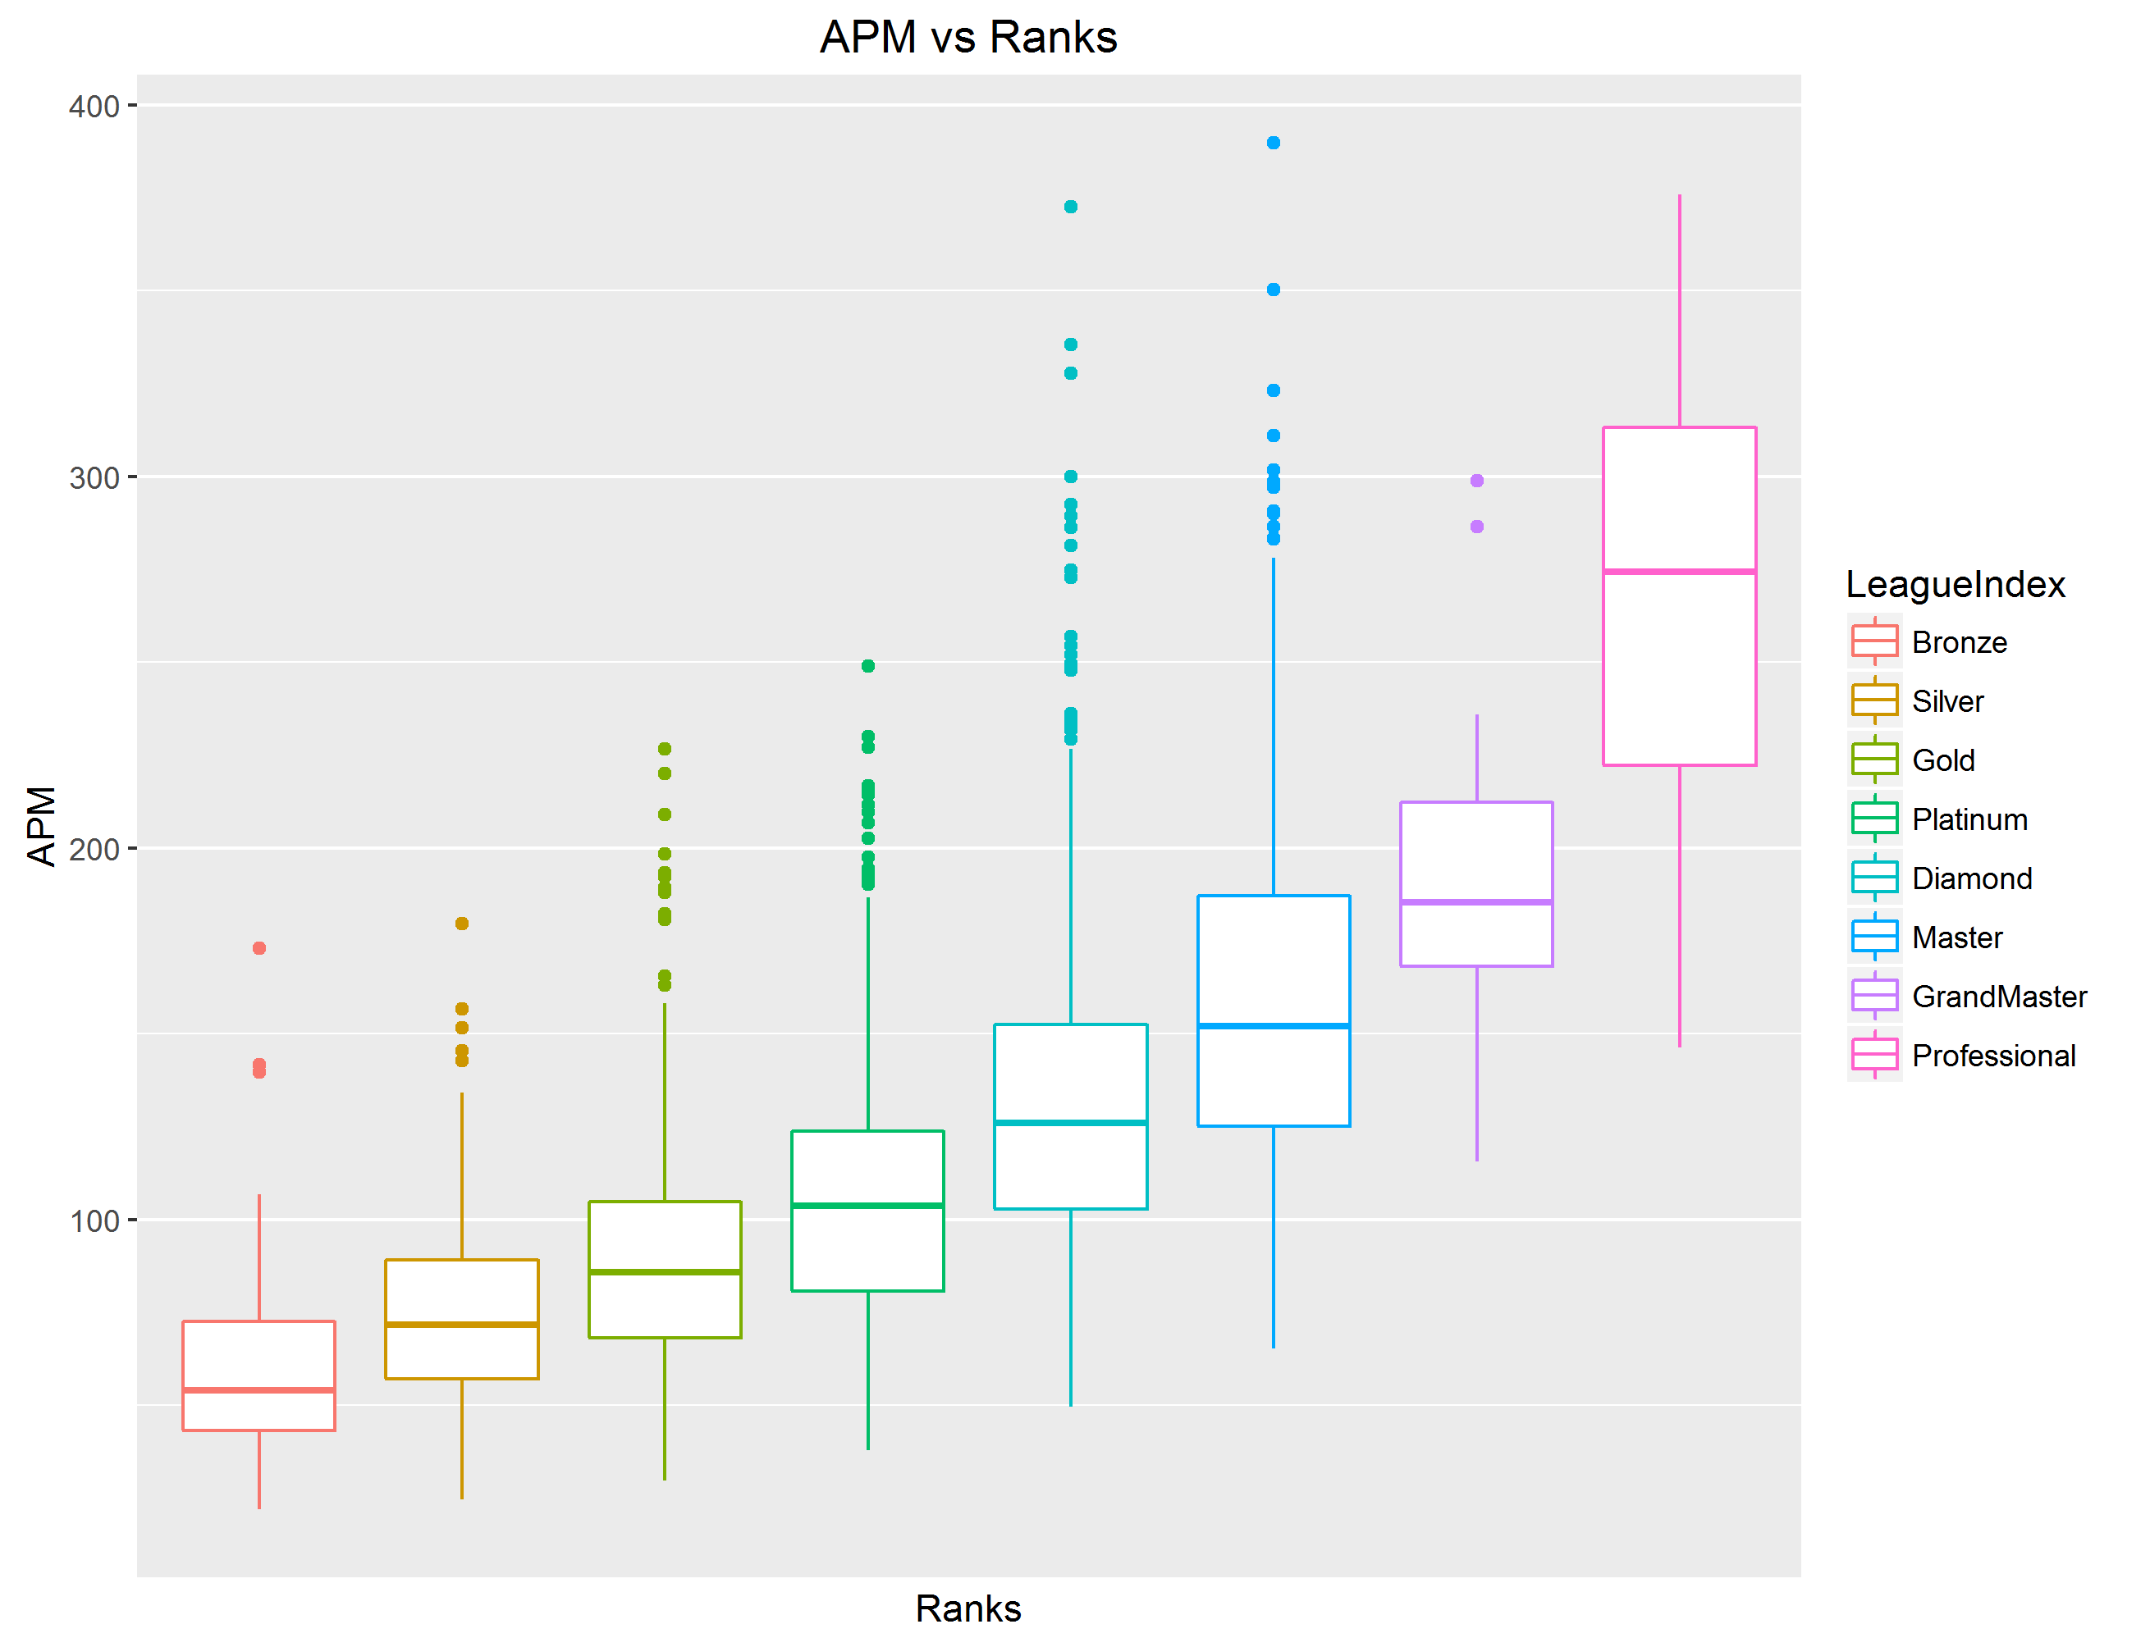

Slide 9
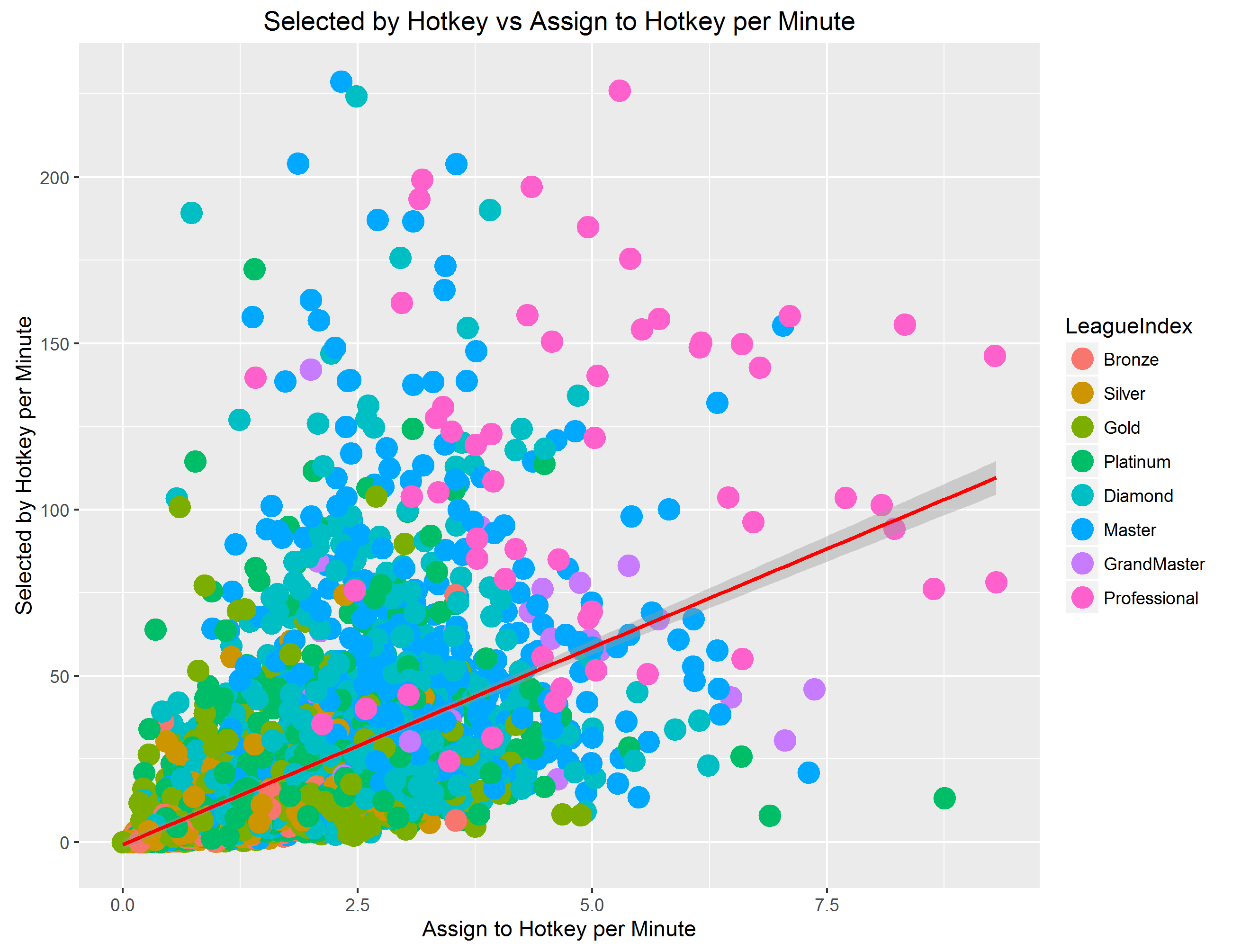

Slide 10
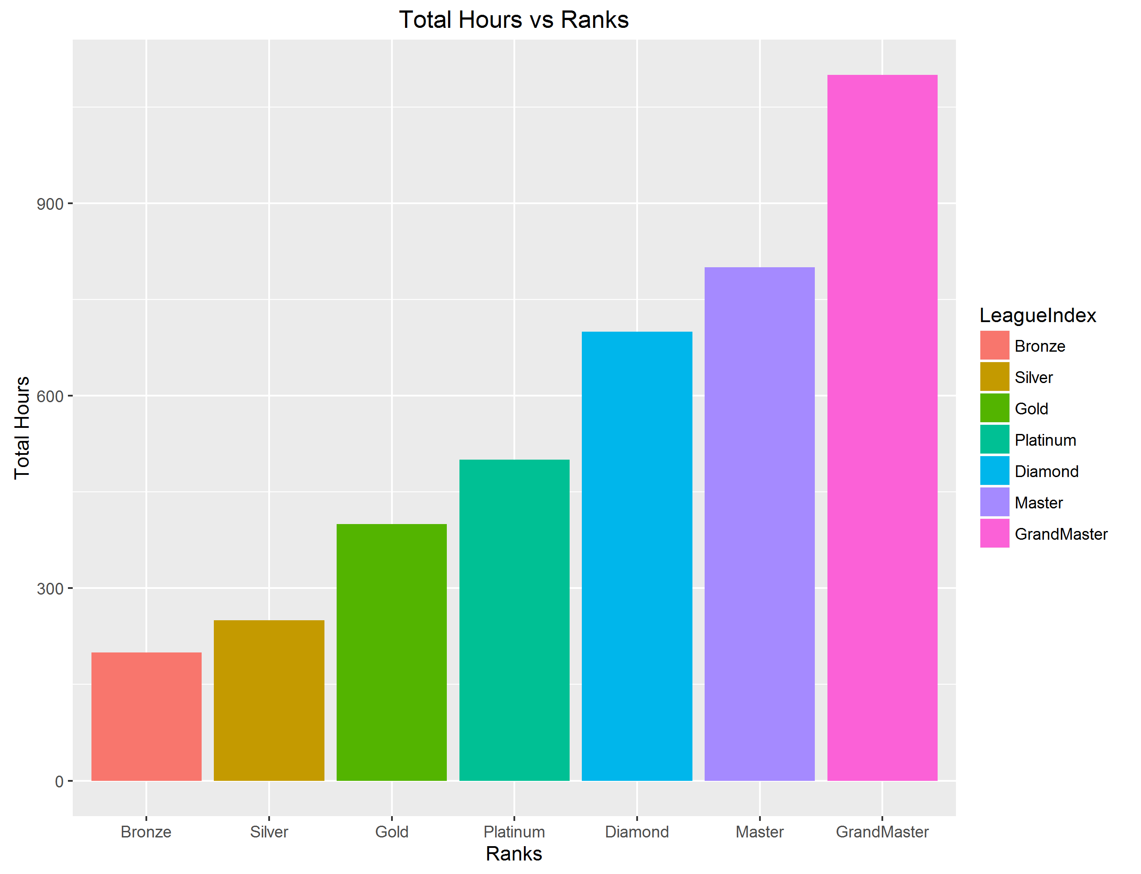

Slide 11
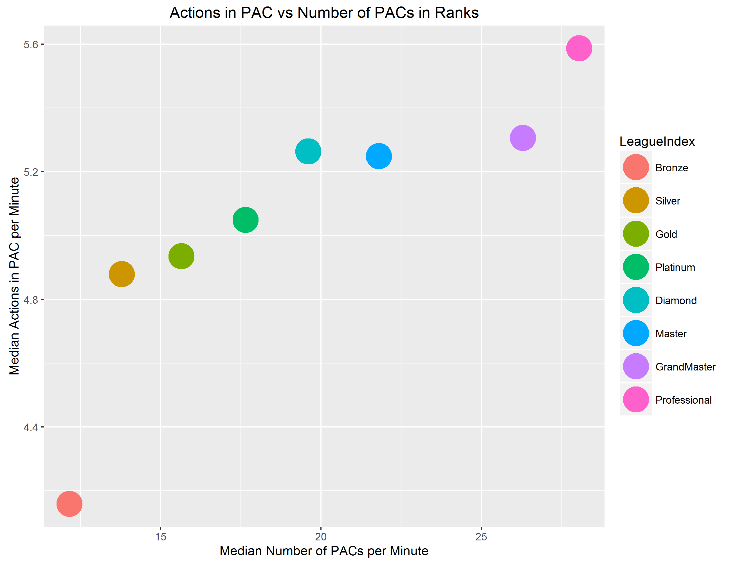

Slide 12
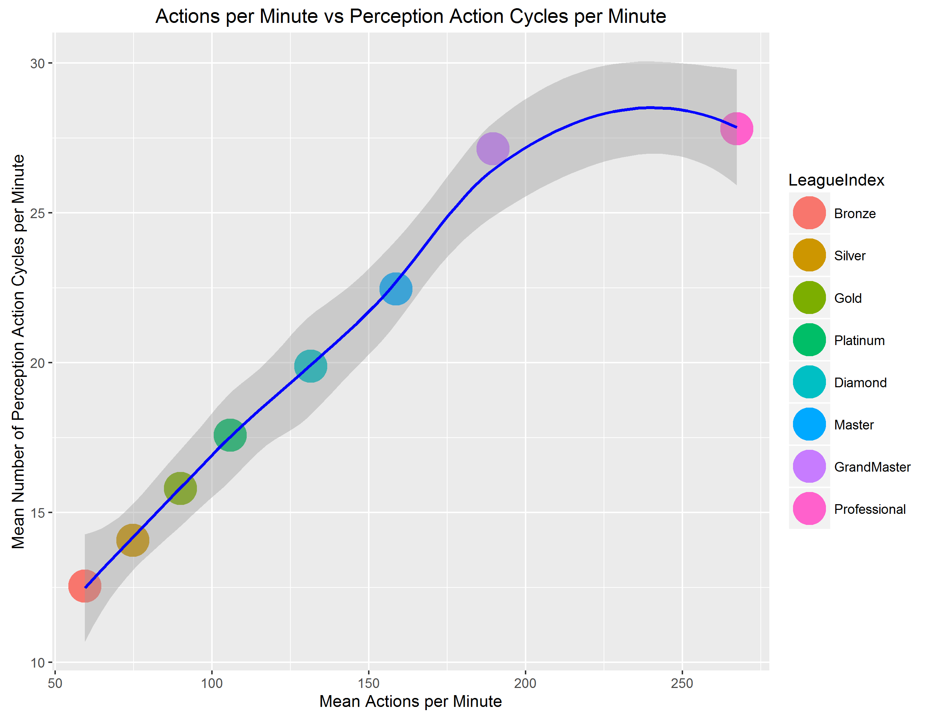

Slide 13
SVM 5-Fold Cross Validation Test
70% Training, 30% Testing
Optimal Gamma 0.012, Optimal Cost 0.32
Train RMSE is 1.005571
Test RMSE is 0.9757243
5 Fold CV RMSE is 0.926072
The model predicts quite well - each variable in the dataset, tested against LeagueIndex, shows a good correlation that higher ranks require a better skill set and invested time.

Slide 14
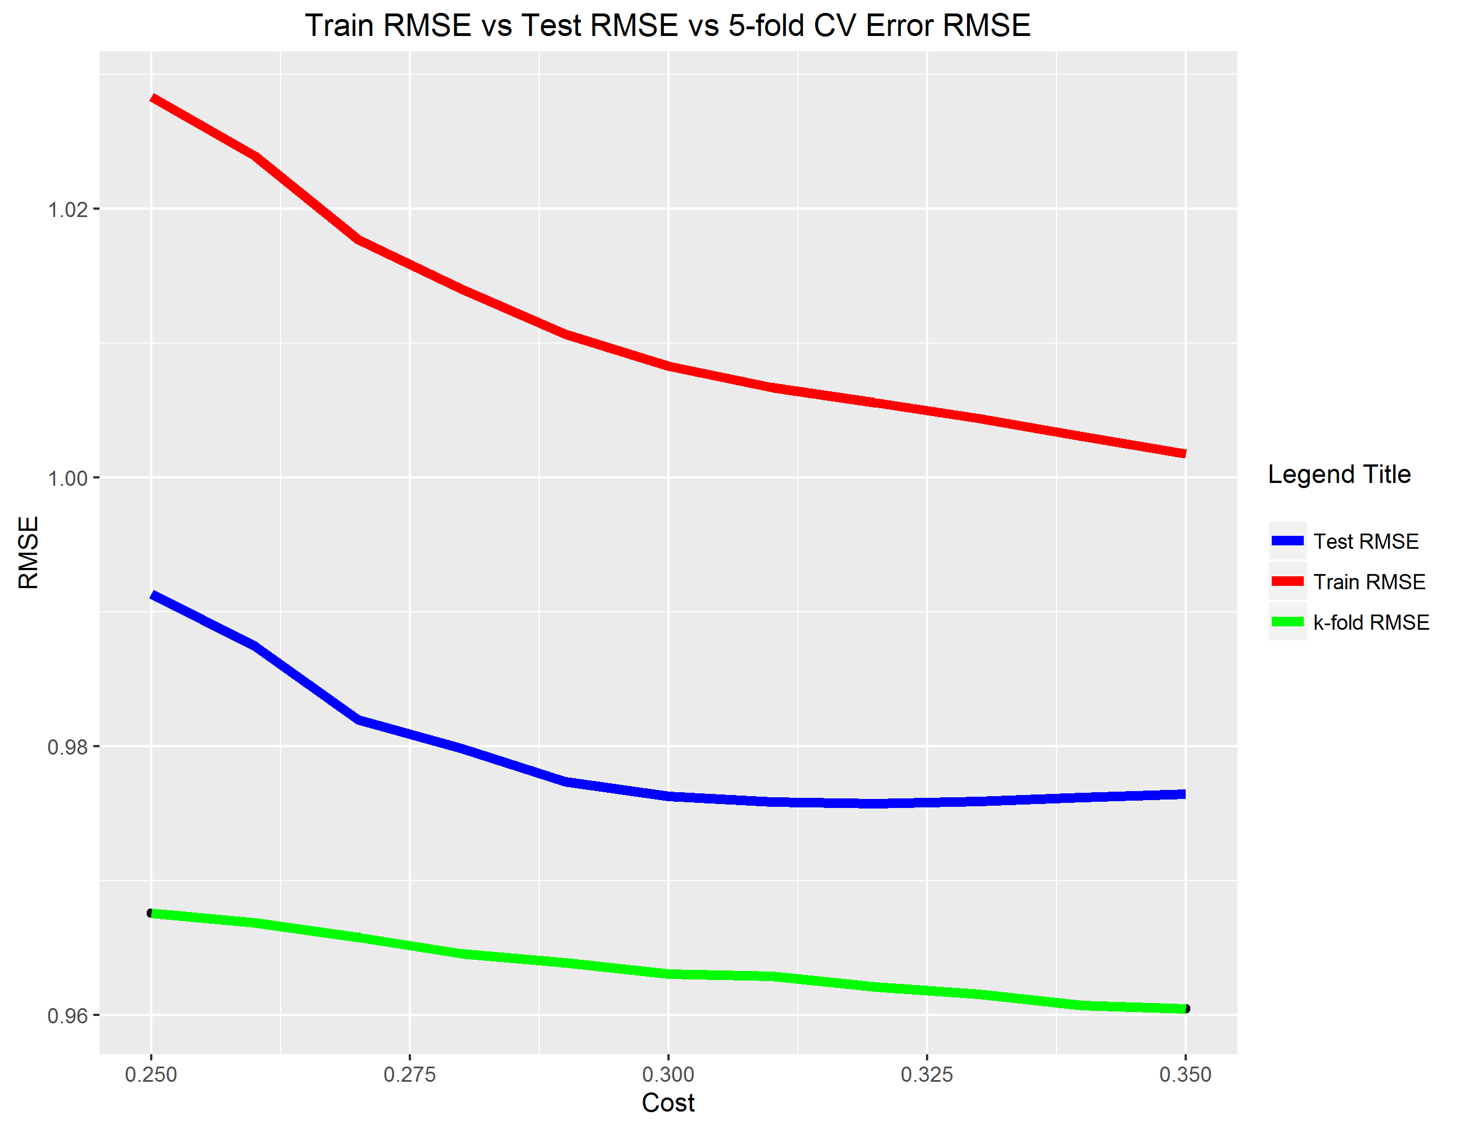

Slide 15
Recommendations
1. PAC and Hotkey Training Plan
2. APM Training Plan
3. E-Sports Profession Talent Separation
E-Sports Player
E-Sports Analyzer
E-Sports Coach
E-Sports Game Tester

Slide 16
Further Research
More Variables for StarCraft II, such as Win/Loss and Country of Origin
Detailed Variables for other genres of competitive games
E-Sports Industry of Professions

Slide 17
Thank you for Listening!!!
Questions, Comments, Discussions?

